Slide 1

Note: The data and information in this document is reflective of a hypothetical situation and client. This document is to be used for KPMG Virtual Internship purposes only.
Sprocket Central Pty Ltd
Data analytics approach
[Division Name] - [Engagement Manager], [Senior Consultant], [Junior Consultant]

Slide 2
Note: The data and information in this document is reflective of a hypothetical situation and client. This document is to be used for KPMG Virtual Internship purposes only.
Agenda
Introduction
Data Exploration
Model Development
Interpretation

Slide 3
Note: The data and information in this document is reflective of a hypothetical situation and client. This document is to be used for KPMG Virtual Internship purposes only.
Introduction
Customers Analysis
Number of cars own by each gender
Number of cars Owned by Age
Past 3 Years Bike Purchases
Number of cars own an each state
Model Development
Job Industry Category

Slide 4
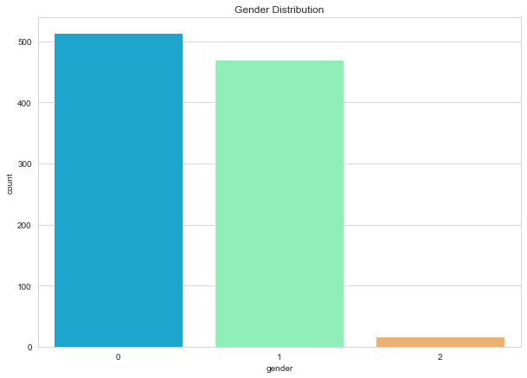
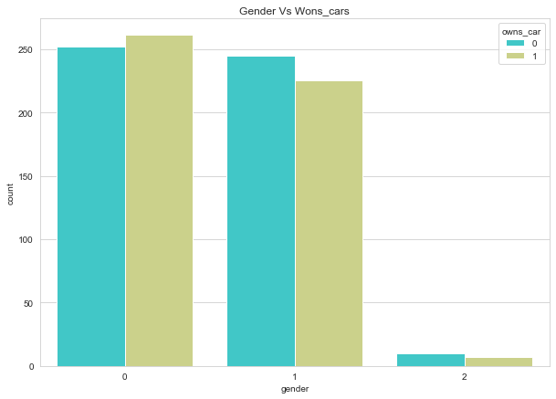
Note: The data and information in this document is reflective of a hypothetical situation and client. This document is to be used for KPMG Virtual Internship purposes only.
Data Exploration
Number of cars own by each gender
.Here 0 = Female and 1 = Male. From the
first graph we can see that number of female is more than male in the dataset. Number of male is 480 and number of female is 520.
Next graph is all about car owned by male and female
So, we can see that female owns car than male. Number of car owned by Female = 270 and Number of cars owned by Male = 250.
So, we should focus on advertisement on Female than Male.

Slide 5
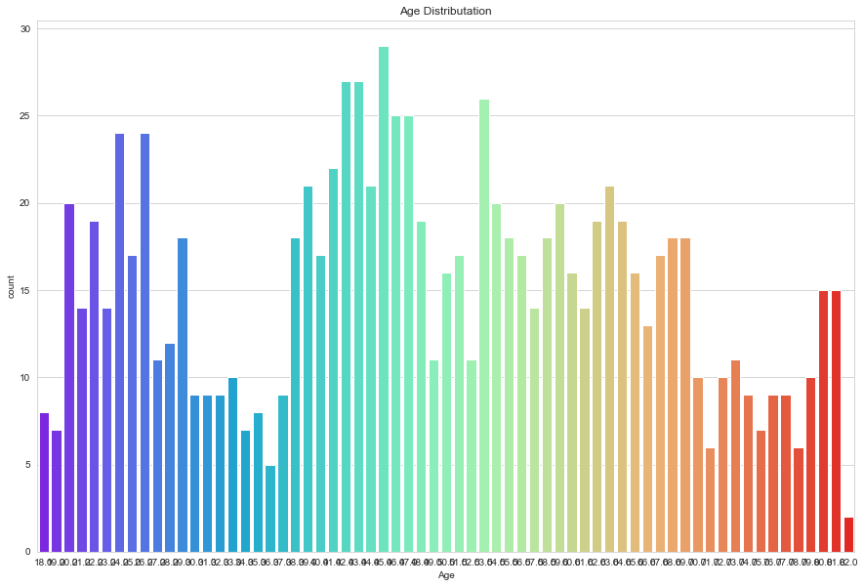
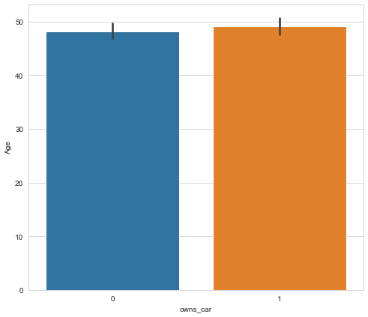
Note: The data and information in this document is reflective of a hypothetical situation and client. This document is to be used for KPMG Virtual Internship purposes only.
Data Exploration
Number of cars Owned by Age
.The first graph is Age Distribution.
The Second graph is between Owns car and Age.
The maximum number of car bought between the age 42-48

Slide 6
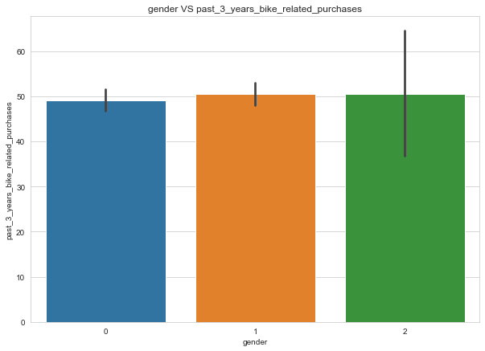
Note: The data and information in this document is reflective of a hypothetical situation and client. This document is to be used for KPMG Virtual Internship purposes only.
Data Exploration
Past 3 Years Bike Purchases
.The graph is showing gender vs bike purchases in 3 years.
Here 0 = Female , 1 = Male and 2 = Unknown gender has purchases maximum number of bikes in last 3 years.

Slide 7
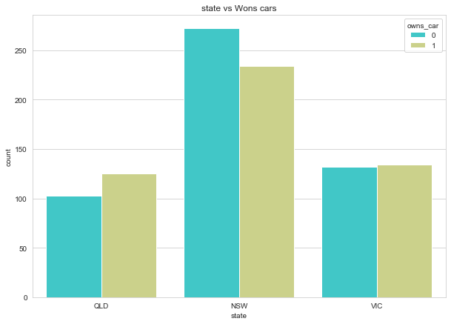
Note: The data and information in this document is reflective of a hypothetical situation and client. This document is to be used for KPMG Virtual Internship purposes only.
Data Exploration
Number of cars own an each state
.The graph is showing the State Distribution on the basis of owning car.
Here maximum number of cars is owned by QLD and minimum number of cars in owned by NSW.

Slide 8
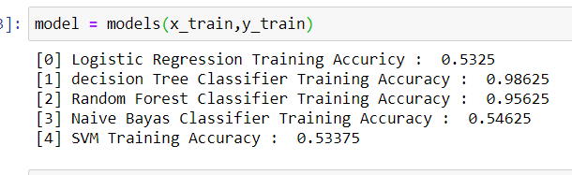
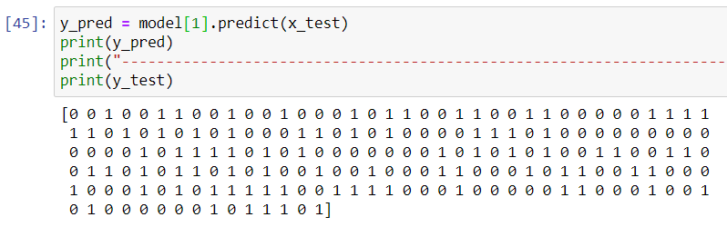
Note: The data and information in this document is reflective of a hypothetical situation and client. This document is to be used for KPMG Virtual Internship purposes only.
Model Development
. We took Owns car as an dependent variable.
By splitting the data set into training and testing model and by using Decision Tree classification we achieved accuracy of 98%.
The second picture showing prediction value of the data set

Slide 9
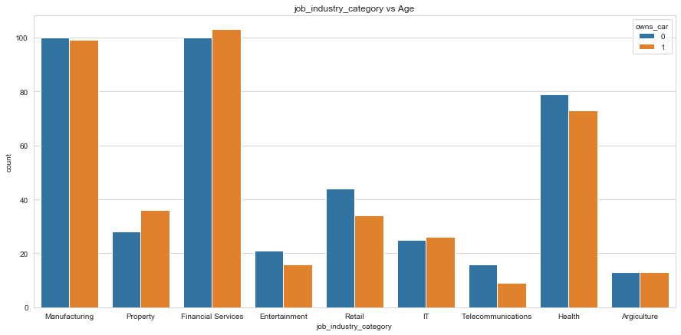
Note: The data and information in this document is reflective of a hypothetical situation and client. This document is to be used for KPMG Virtual Internship purposes only.
Interpretation
Job Industry Category
Here most of the car is owned by job category of “Financial Service”
The minimum car owned by job category of “Telecommunication”.
So, we should focus on advertisement on
job category of “Telecommunication”.
Place any supporting images, graphs, data or extra text here.

Slide 10
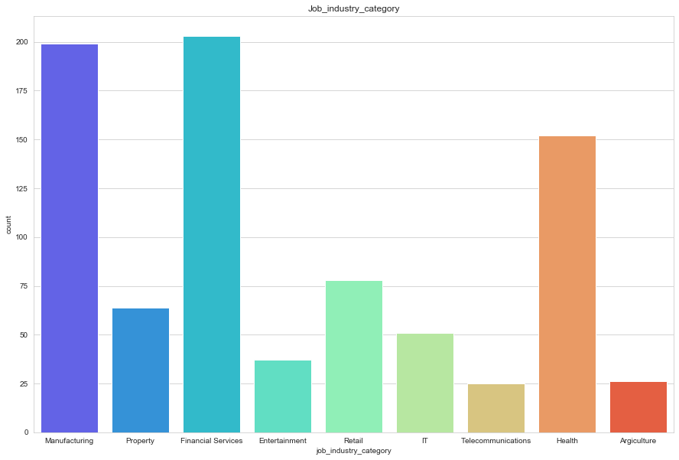
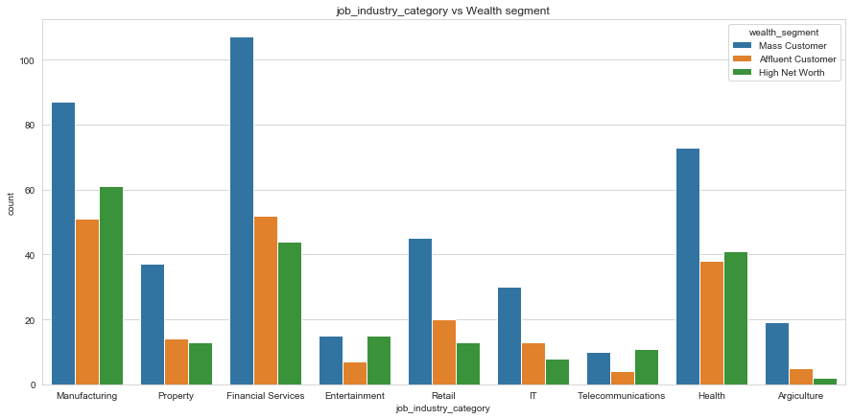
Note: The data and information in this document is reflective of a hypothetical situation and client. This document is to be used for KPMG Virtual Internship purposes only.
Interpretation
Job Industry Category
The maximum number of customer is present in Financial Service and Manufacturing.
The rest Industries is still same.
Wealth Segment
The maximum number of high net worth is present in Manufacturing.
So, the company should aim on the people present in Manufacturing and Financial Service jobs.
Place any supporting images, graphs, data or extra text here.

Slide 11
Note: The data and information in this document is reflective of a hypothetical situation and client. This document is to be used for KPMG Virtual Internship purposes only.
Appendix

Slide 12
Note: The data and information in this document is reflective of a hypothetical situation and client. This document is to be used for KPMG Virtual Internship purposes only.
Appendix
This is an optional slide where you may place any supporting items.

